Slide 1
When do you need data science?
Jeff Leek
@jtleek
www.jtleek.com

Slide 2
Startup
Focus on infrastructure

Slide 3
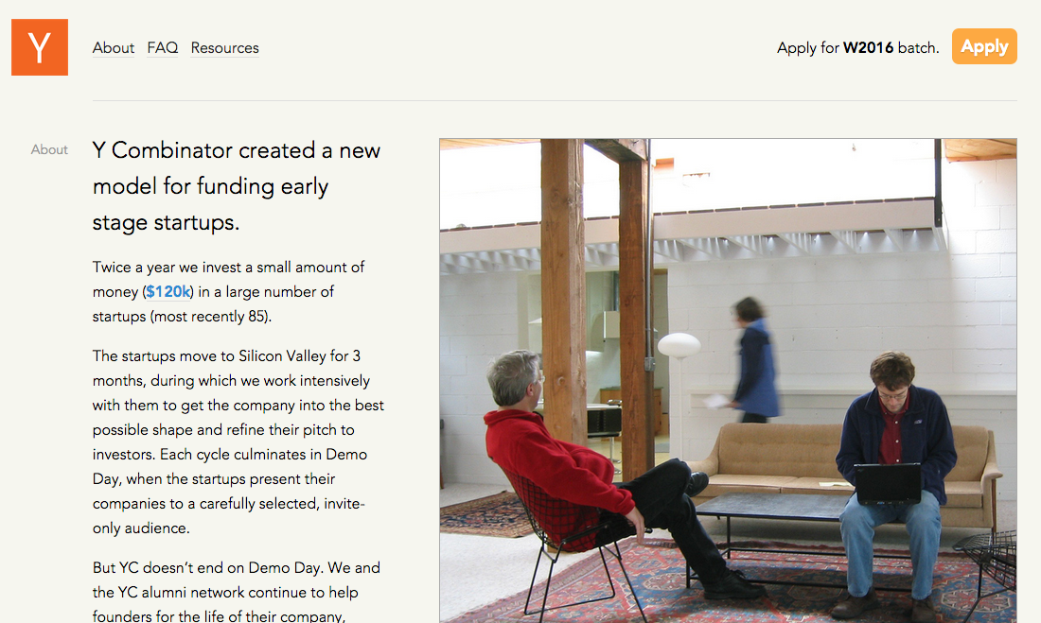
https://www.ycombinator.com/

Slide 4
Midsize organization
Infrastructure
Data science
Data products

Slide 5
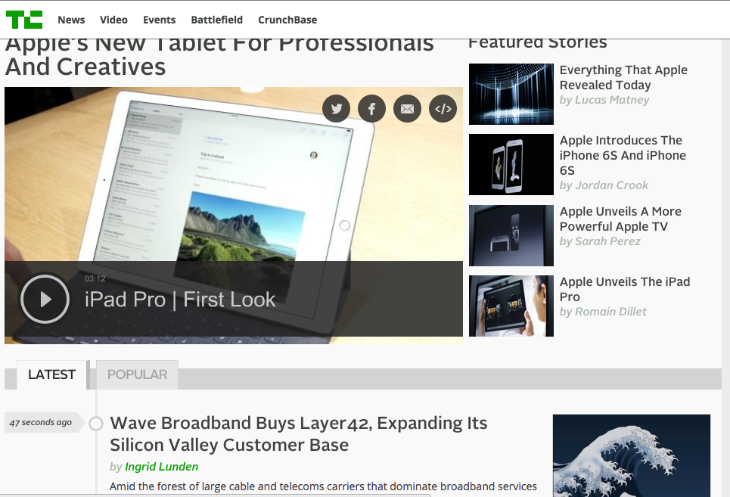
http://techcrunch.com/

Slide 6
Large organization
Infrastructure
Data science
Data products
Data coordination

Slide 7
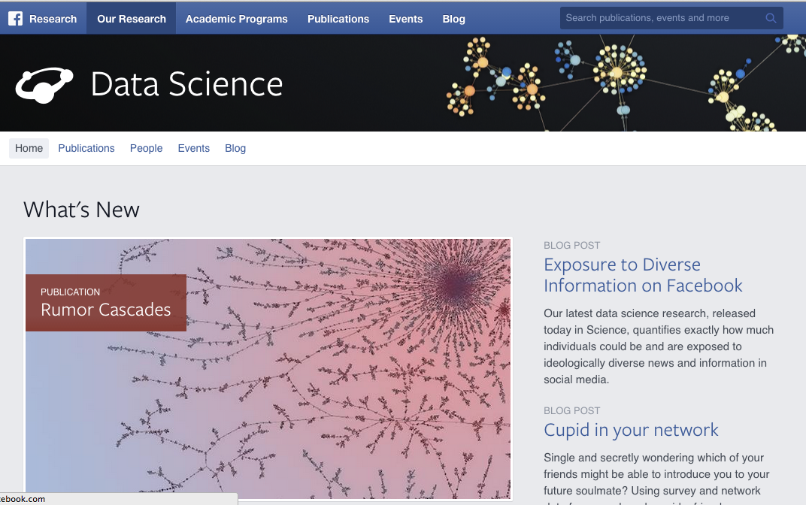
https://research.facebook.com/datascience

